Slide 1



Basic Programs and Expressions
What is a program?
Expressions
Kinds of expressions
Evaluation Order
Naming expressions
Interactions vs. Definitions windows
Pyret Documentation
Notes:
See notes throughout for commentary!

Slide 2
Workshop is:
Workshop is not:
A place for everyone to learn and ask conceptual questions
A supplement to lecture
A place to get student feedback on what concepts are clear and unclear
A resource for extra example problems
A place for debugging or homework questions — that’s for TA hours
An extra assignment for students
A TA lecturing at you (ask stuff so we can help you more!!)
Notes:
Welcome!!! Also, don’t ask homework questions please!

Slide 3
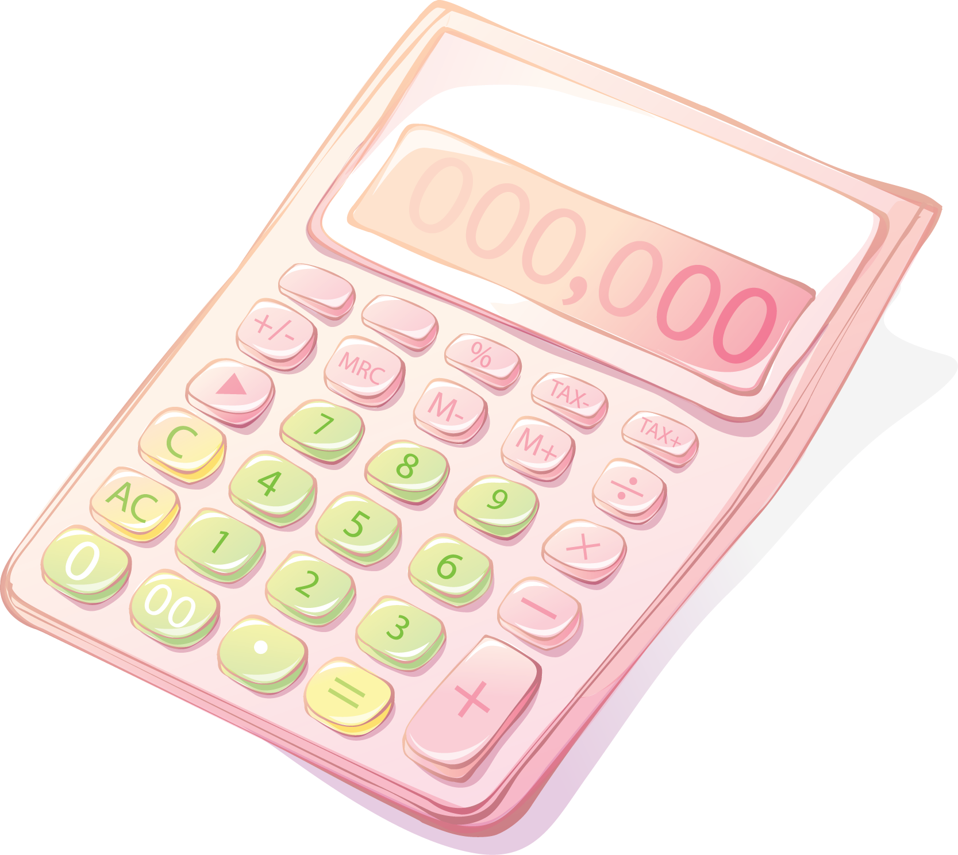
1.1. What is a program?
Instruction for your computer
Must be very specific
Something to be read by people
Must be readable (comments, style, organization)
A program can:
Add a definition to use later
Draw a picture
Add numbers
And more!! 😄
Fig. A: A computer is just like a big boi calculator that can do cooler stuff — typing 1 + 1 into your calculator is typing a program!! In fact, the first computers just added numbers (that’s why they’re called computers).
Notes:
A program is both something that must be technically correct and easy to read. Programs are instructions to computers, but they are also documentation for people to understand what the computer is doing.
If your programs aren’t specific and correct, the computer won’t be able to understand you. However, even if your code runs correctly, without good style, commenting, and layout, other people (or even yourself) reading your code will be confused as to what it does (including your graders in this class 😮). Just as an essay written with no punctuation, bad grammar, or poor handwriting can be confusing, code that has undescriptive names, bad spacing, really long lines, or no commenting to explain what it does can be totally unreadable!
Code doesn’t have to be confusing — if it’s properly documented and organized, it can be read just as you would an essay. In this class, you’ll learn how to read and write code that you understand!

Slide 4
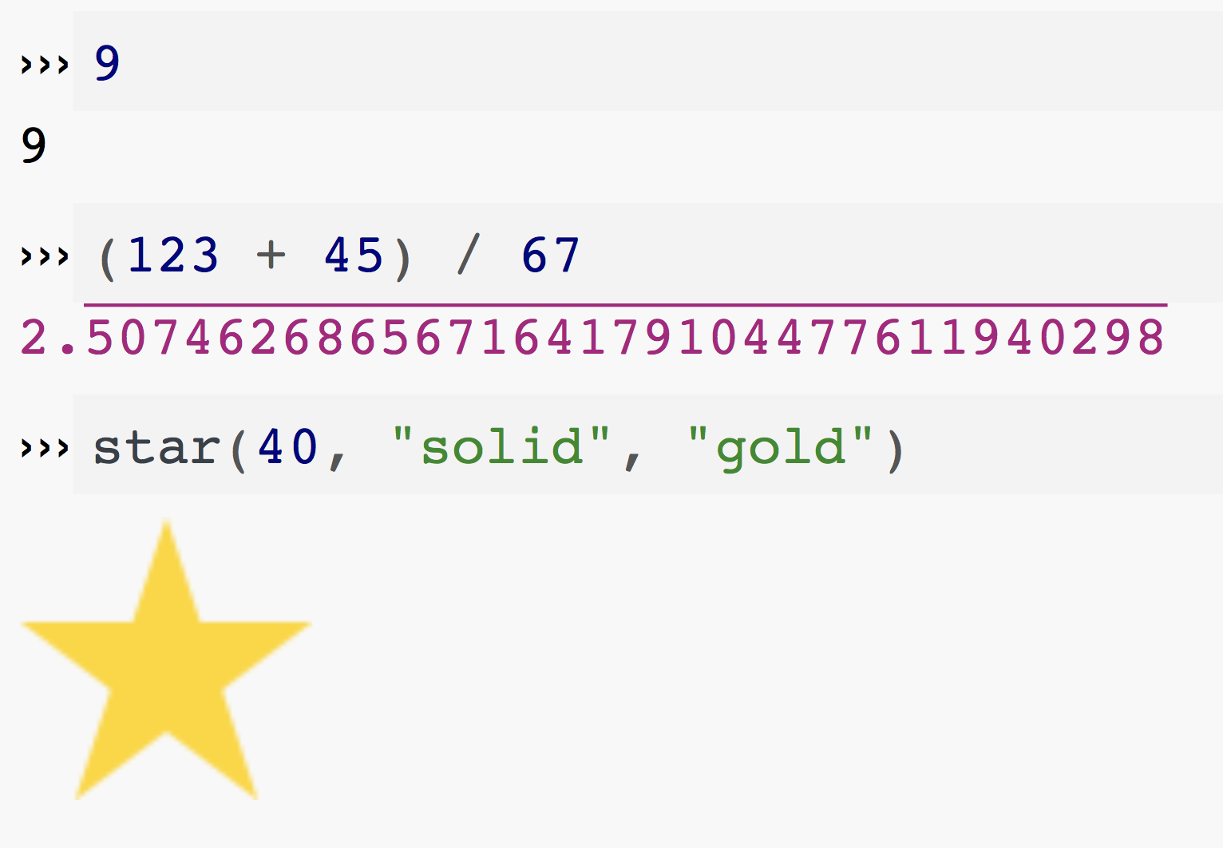
1.2. Expressions
Programs that do computations
Evaluate to an “answer”
If you type an expression, the computer takes it and “evaluates” it, much like you would evaluate information your eyes process.
The computer then “gives back” something — what it concludes the value of the expression is.
Try it out by going to code.pyret.org!
Fig. B: Some expressions (what the user typed) and their values (Pyret’s response) in the interactions window (the right panel) of code.pyret.org. Note that every expression, when evaluated by Pyret, has a response.

Slide 5
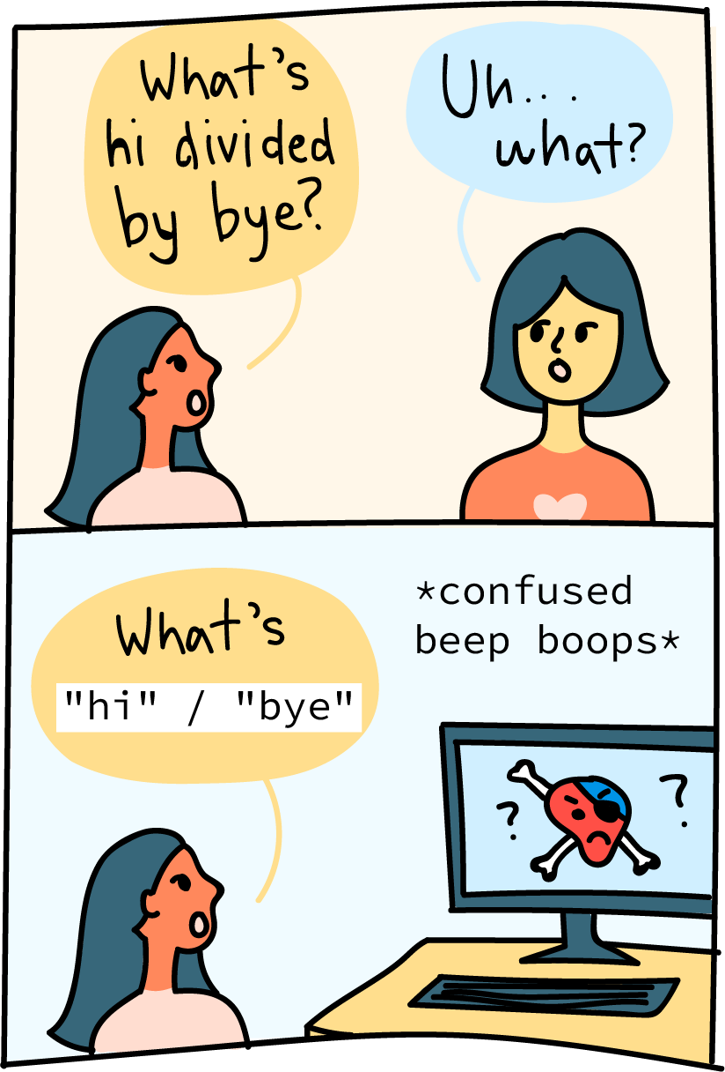
1.3. Kinds of Expressions
Numbers
Examples: 0, -10, 0.4
Some operations: +, –, <, num-min
Strings
Ex: "", "hiii", "111"
Images
Ex: circle(2, "solid", "red")
Some operations: overlay-align, rotate
Notes:
Why is knowing the difference between kinds of expressions important? They’re the building blocks of everything we do in Pyret. They’re also a great example of the unconscious thinking we do every day that must be made explicit in a program.
If I tell you, “hey, can you divide the word ‘hi’ by the word ‘bye’?,” you’d probably say something like, “uhh… what do you mean? That doesn’t make any sense. Dividing is for numbers.” This comes really naturally to us. Pyret is the exact same way! If you try to say: >> "hi" / "bye"
Pyret will give you an error:
The / operator expects to be given two Numbers.
In Pyret, all operators (such as rotate, num-min, –, and more which you will continue to learn) expect a certain number and kind of “arguments” as input and output a certain kind of value as an answer. To break that statement down a little more, let’s continue using / as an example.
The operator / expects 2 Numbers as input — that’s why if you use / with 2 Strings, like above, it breaks! Additionally, dividing a Number by a Number should always produce a Number! That’s why you’re allowed to say something like:
>> (2 / 4) / 8
By the order of operations, you should compute (2 / 4) first, then compute that answer over 8. How does Pyret know everything will be okay? (2 / 4) is an expression that hasn’t been computed yet, so it could theoretically be anything. However, since using / should always produce a Number, Pyret feels confident that (2 / 4) should be a Number at the end even if it hasn’t figured out what the value of (2 / 4) is right now. Thus, it also feels confident that (2 / 4) can be used as the argument to another division!
You’ll learn more about this and how they interact with operators later, but for now, it’s important to understand that learning about kinds of expressions and values is crucial to how programs work and are a great sanity check in coding (sort of like unit analysis in physics). They’re also something that you do unconsciously every day (for example, toast should go in a toaster, only non-metal stuff should go in a microwave)!

Slide 6
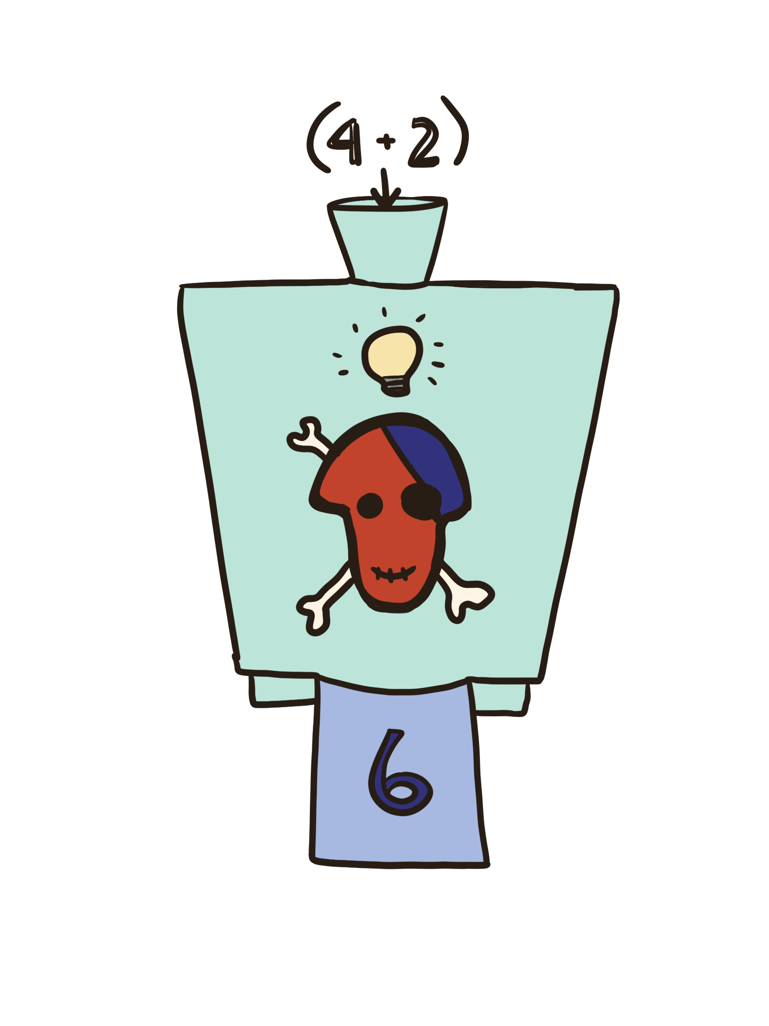
1.4. Evaluation Order
How does something like (4 + 2) / 3 work?
What is the operator / dividing?
Shouldn’t / expect 2 numbers?
Even though (4 + 2) isn’t a number, it is an expression that evaluates to a number
This works for anything!!

Slide 7

1.4. Evaluation Order
Image example!
Let’s say we want to create the image below… how could we do this using overlay-align?
But doesn’t overlay-align only operate on two images?
How can we use overlay-align to put more than two images together???

Slide 8
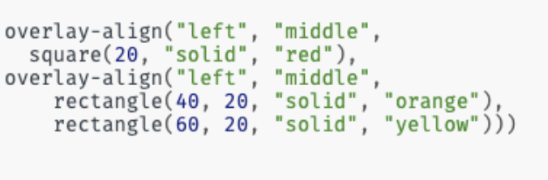
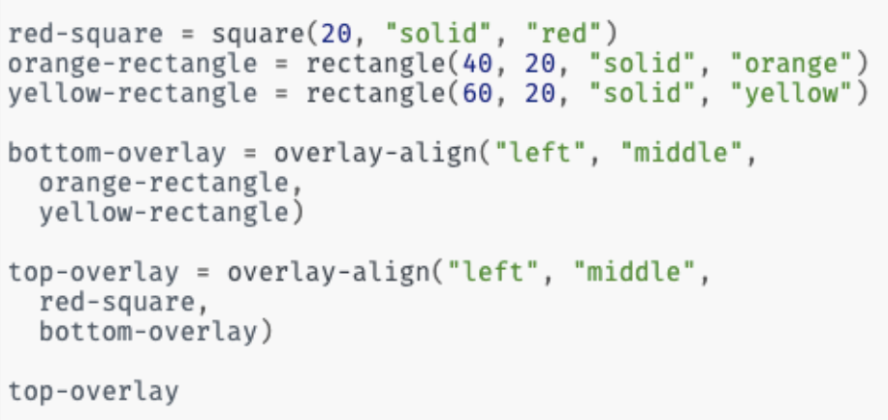
1.4. Evaluation Order
We can go about this in two ways!
What looks different between these?
What looks similar?
Is one better?

Slide 9
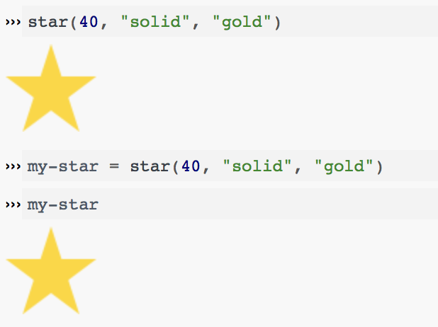
1.5. Naming Expressions
In addition to expressions that output something we can also save the output to a name
This is called a definition!
Use the = symbol to bind a name to a value!
NAME = EXPRESSION
Fig. E: star(40, “solid”, “gold”) is an expression. When you give it to Pyret, it evaluates to an Image. However, if you enter a definition binding the name my-star to the same expression, Pyret doesn’t output anything! It is just associates the name with the expression. Later in the code you can use the name to refer to associated expression.

Slide 10

1.5. Naming Expressions
If you use the name x without defining it first in a statement, you get an error.
Names must be given a value before being used
In Pyret, names are immutable, which is a fancy way of saying they can only be defined once*
Defining x to be 3 allows you to use x as if it were 3.
Because x has previously been defined, Pyret will give an error if you try to define it again.
Notes:
*once in every environment. You don’t need to know what this means, but if you want to know feel free to ask :)

Slide 11
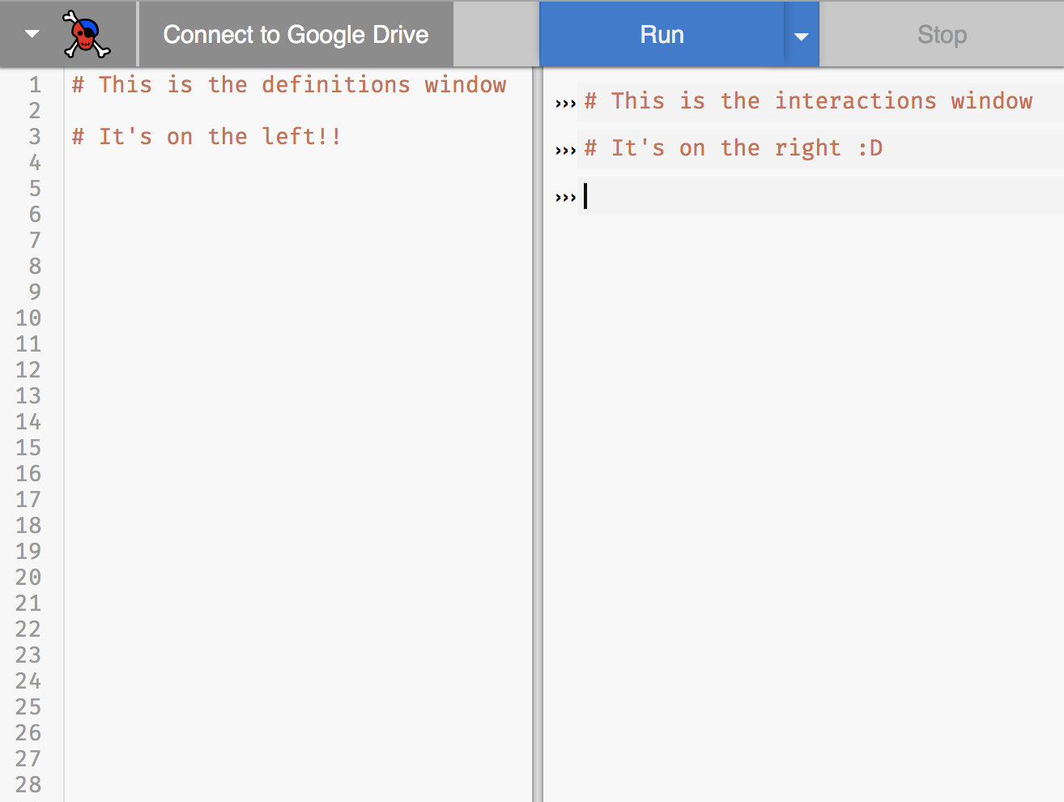
1.6. Interactions vs. definitions windows
Use the interactions window for:
Trying out expressions
Checking syntax
Use the definitions window for:
Building complex expressions
Naming expressions
Using previously defined expressions
SAVING CODE!
Fig. D: The definitions window on the left has line numbers, while the interactions window on the right has arrows. (>>>)

Slide 12
Practice with Windows!
I want to see if I can make a blue circle?
I want to define my-shape as a blue circle and use it later in my code?
I want to see if Pyret will accept this: print “5”?
I want to start my assignment now and finish it later?
Which window would I use if...
Notes:
Answer key:
Interactions
Definitions
Interactions
Definitions

Slide 13

1.7. Pyret Documentation!!!!!
https://www.pyret.org/docs/latest/
This is such a useful general resource!
https://www.pyret.org/docs/latest/image.html
Here is the specific image documentation you may find useful for this hw!

Slide 14
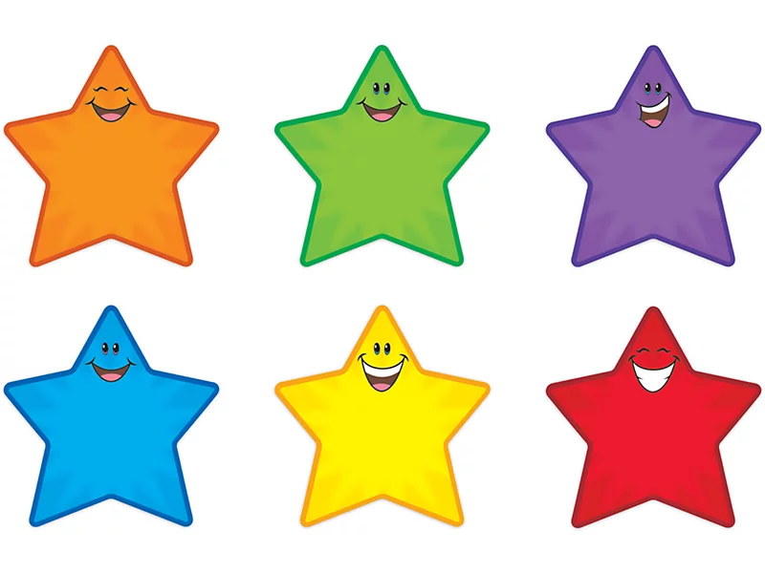
Any questions?? Thanks for coming!

Slide 15

Bonus fun collaborative zoom drawing from workshop! Come to workshop :D
Notes:
(done while waiting for people to show up :D)

